Slide 1
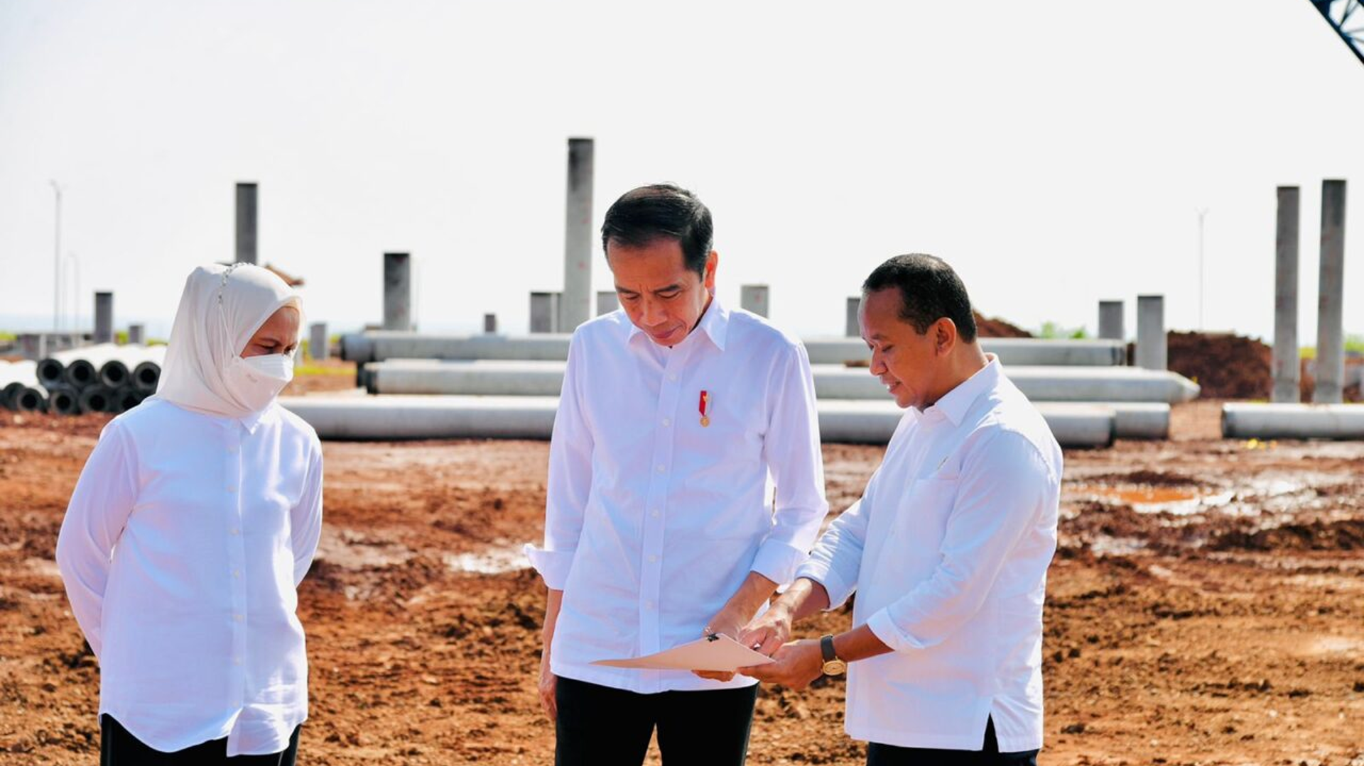
Overview of FDI Trend, Investment Incentives and Strategic Investment Projects
Mr. Heldy Satrya Putera
Acting Deputy Minister for Strategic
Downstream Investment
25 October 2022

Slide 2
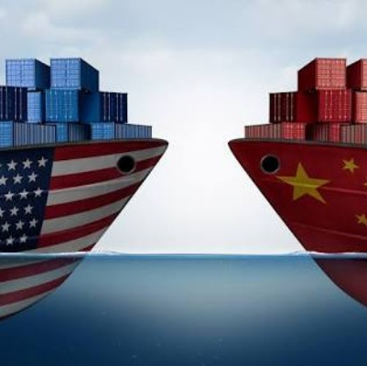
Negative Global Trends
1
2
3
USA vs China
Trade War
COVID-19
Pandemic
Russia vs Ukraine War
4
5
China – Taiwan
Tension
Food & Energy Crisis

Slide 3
Economic Growth of Various Countries (%, y-o-y)
USA
EU
China
South Korea
India
Singapore
Vietnam
Indonesia
Cumulatively, Indonesia's economy in 2021 grew 3.69% year-on-year and in the second quarter of 2022 the growth increased to 5.44%.
Source: tradingeconomics.com
3

Slide 4
Inflation in G20 Countries
(August 2022, year-on-year)
Inflation Impact on UK
G20 Countries Inflation (y-o-y%)
Inflation in the UK is high, reached 9.4% in September, leading to higher prices for basic necessities
The pound sterling fell more than 20% after the UK government announced a fiscal policy package on September 21st, 2022.
Energy costs for UK households are expected to rise 80% this year
Source: tradingeconomics.com
4

Slide 5
Investment Realization 2021 – September 2022
(not including Upstream Oil and Gas and Financial Services Sector)
Investment Realization
Jan – Dec 2021*
USD 61.7 bil
Investment Realization
Jan – Sep 2022
USD 62.1 bil
100.1%
74.4%
100.1%
Investment target 2021*
USD 61.1 B
Investment target 2022
USD 83.6 T
Investment target 2021*
USD 61.1 B
Local worker absorption 965,122
Local worker absorption 1,207,893
Based on Investment Sources​
Based on Distribution​
Based on Investment Sources​
Based on Distribution​
​
DDI
USD 30.6 B
(49.6%)
FDI
USD 31.1 B
(50.4%)
Outside Java
USD 32.1 B
(52.0%)
Java
USD 29.6 B
(48.0%)
DDI
USD 28.8 B
(46.3%)
FDI
USD 33.4 B
(53.7%)
Outside Java USD 32.9 B
(53.7%)
Java
USD 29.3 B
(46.3 %)
*Foreign Exchange 2021: Rp. 14,600/USD
*Foreign Exchange 2022: Rp. 14,350/USD
Source: Ministry of Investment/BKPM

Slide 6
Top 5 FDI in Indonesia 2022 Q3
(Not including upstream oil and gas, financial sectors)

Slide 7
Top 5 FDI in Indonesia Jan – Sep 2022
(Not including upstream oil and gas, financial sectors)

Slide 8
FDI Trends
2019, 2020, and 2021
2019
2020
2021
Rank |  | Country |  | Investment (USD Million)
 | 1 |  | Singapore | 6,509
 | 2 |  | China | 4,744
 | 3 |  | Japan | 4,310
 | 4 |  | Hongkong | 2,891
 | 5 |  | Netherlands | 2,596
 | 6 |  | Malaysia | 1,357
 | 7 |  | South Korea | 1,070
 | 8 |  | USA | 989
 | 9 |  | Britis Virgin Islands | 743
 | 10 |  | Australia | 348
Rank |  | Country |  | Investment (USD Million)
 | 1 |  | Singapore | 9,779
 | 2 |  | China | 4,842
 | 3 |  | Hongkong | 3,535
 | 4 |  | Japan | 2,588
 | 5 |  | South Korea | 1,841
 | 6 |  | Netherlands | 1,422
 | 7 |  | Malaysia | 1,045
 | 8 |  | USA | 749
 | 9 |  | Taiwan | 454
 | 10 |  | Australia | 348
Rank |  | Country |  | Investment (USD Million)
 | 1 |  | Singapore | 9,390
 | 2 |  | Hongkong | 4,609
 | 3 |  | China | 3,160
 | 4 |  | USA | 2,537
 | 5 |  | Japan | 2,263
 | 6 |  | Netherlands | 1,761
 | 7 |  | South Korea | 1,640
 | 8 |  | Malaysia | 1.364
 | 9 |  | Bermuda | 674
 | 10 |  | Swiss | 599
8
8

Slide 9
Japanese Investment in Indonesia
2017 - Jun 2022
Based on sector
Based on location
$7.5 billion
36%
$19.7 billion
95%
Electricity, Gas and Water
JAVA
Vehicle and other transportation industry
SUMATRA
BALI-NUSA TENGGARA
Housing, Industrial estates, and office buildings
SULAWESI
Chemical and pharmaceutical industry
KALIMANTAN
Metal industry
MALUKU-PAPUA
Source: Ministry of Investment/BKPM

Slide 10
TREND BASED ON SECTORS
Year 2019, 2020, and 2021
2019
2020
2021
No | Sectors | USD (B) | %
1. | Transportation, Warehouse, and Telecommunication | 8.95 | 17.2%
2. | Electricity, Gas, and Water Supply | 8.11 | 15.6%
3. | Housing, Industrial Estate, and Office Building | 4.58 | 8.8%
4. | Metal, Metal Goods, Except Machinery, and Equipment Industry | 3.96 | 7.6%
5. | Mining | 3.96 | 7.4%
No | Sectors | USD (B) | %
1. | Transportation, Warehouse, and Telecommunication | 9.32 | 17.5%
2. | Electricity, Gas, and Water Supply | 6.56 | 12.3%
3. | Metal, Metal Goods, Except Machinery, and Equipment Industry | 6.10 | 11.5%
4. | Housing, Industrial Estate, and Office Building | 4.92 | 9.2%
5. | Construction | 4.57 | 8.6%
No | Sectors | USD (B) | %
1. | Metal, Metal Goods, Except Machinery, and Equipment Industry | 7.56 | 13.0%
2. | Housing, Industrial Estate, and Office Building | 7.56 | 13.0%
3. | Transportation, Warehouse, and Telecommunication | 6.91 | 11.9%
4. | Electricity, Gas, and Water Supply | 5.25 | 9.1%
5. | Mining | 5.23 | 9.0%
In line with the policy of the President of the Republic of Indonesia related to economic transformation from the primary sector industry to value-added (downstream) based industries, starting from 2019 to 2021, the Metal, Metal Goods, Except Machinery, and Equipment Industry sectors increased by 90.7% from 3.96 Billion USD to 7.56 Billion USD .
Source: Ministry of Investment/BKPM, 2022

Slide 11
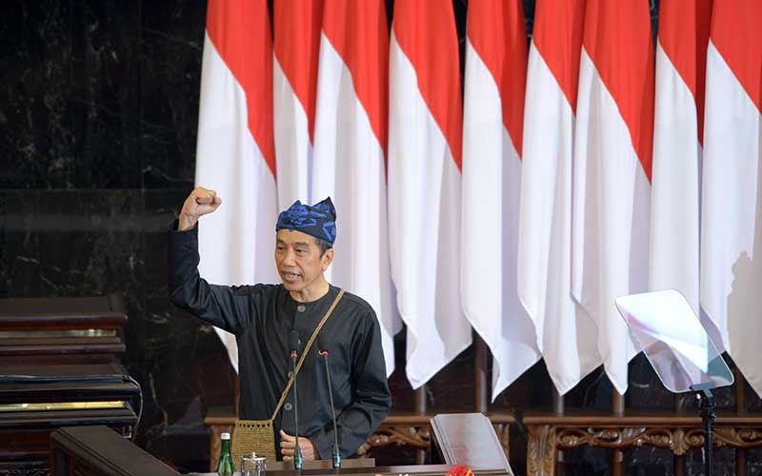
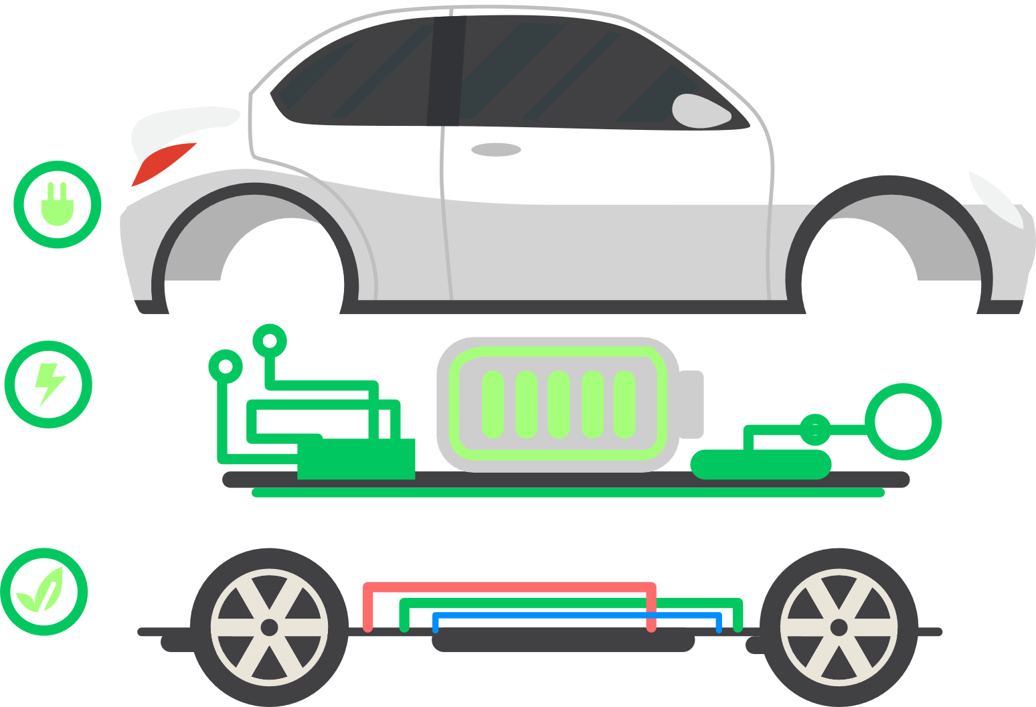
Potential Sector
to promote Sustainable Investment
Green Economy
Infrastructure
Electric battery-based Automotive industry
Energy, particularly new and renewable
Blue Economy
“The investment ecosystem is intended to strengthen the development of an innovation and technology-based economy, in particular towards a sustainable green economy and blue economy.”
(Speech of President Jokowi during the Annual Session of the MPR RI and the Joint Session of the DPR RI - DPD RI in 16 August 2021)
Fisheries sector and marine andcoastal resources (Example: Maluku National Fish Barn/MLIN)
Coral reef conservation projects as a natural carbon capturer and maintain ecosystem balance.
Source: Ministry of Investment/BKPM

Slide 12
Investment Priority Sectors:
Economic Transformation from Primary Sector based to Valued-Added Based (Downstream)
Labor Intensive Industry that Export Oriented
Pharmaceutical, Chemical, and Medical Devices Industry
Infrastructure, Digital Economy
Automotive Industry
Electronic Industry,
Semiconductors, IT & Communication
Mining Industry which will create added value
Renewable Energy
Source: Ministry of Investment/BKPM

Slide 13
Indonesia encourages the development of Downstream
Nickel Industry to become the global player of BEV industry
Electric Car Components Based on Cost
World Nickel Ore Reserve Comparison
35% Baterry
15% Electric Motor
50% Other components
Battery components in widely used electric cars
Nickel-Cobalt-Aluminium (NCA)
80% Nickel
15% Cobalt
5% Aluminum
Nickel-Mangan-Cobalt (NMC811)
80% Nickel
10% Mangan
10% Cobalt
Indonesia is the the world’s largest nickel ore reserves, accounting for 23.7% of the world's reserves.
Source: Nickel Institute, Statista, Indonesian Ministry of Energy and Mineral Resources

Slide 14
Downstream as an Instrument to be a Developed Country
Strong Industrial Growth Foundation
(2020)
Innovation and Global Role
(2035)
GDP
GDP
Diversification and Increase of Added Value
(2025)
Industrial Adaptability
(2040)
GDP
GDP
Sustainable Industry
(2045)
Advanced Industrial Base
(2030)
GDP
GDP
Downstreaming is an effort to develop a sustainable industry. Since massive industrial downstreaming process begin, the growth of added value has a significant impact on job number and state income.
Source: Indonesia 2045, Bappenas

Slide 15
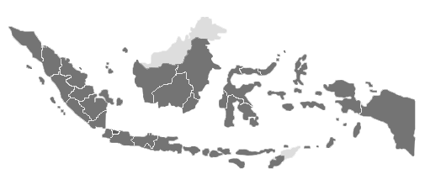
47 Sustainable Investment Projects
with Pre-Feasibility Study
https://regionalinvestment.bkpm.go.id/
42
KI Ladong Management
Aluminum Extrusion Industry
DPP Manado-Likupang
7
22
CPO industry
34
10
DPP Morotai
DPP Toba Lake
Alumina Refinery Industry
5
CPO Industry
13
Cocoa Industry
Coconut Industry
37
21
Nickel Sulfate Smelter
27
15
CPO industry
30
Bitung
Seaport
Sorong Seaport
25
29
Food Estate - Sago Industry
CPO Industry
Oleochemical Industry
Ferro Nickel Stainless Smelter
DPP Raja Ampat
6
Gambier (textile dye) Industry
28
DPP Bangka Belitung
19
36
26
Cocoa Industry
47
35
8
24
Slab Billet Steel Smelter
Coal Downstreaming Industry
16
20
Nickel Smelter
32
31
23
18
33
Nutmeg
Industry
Coffee Bean Industry
Sponge Iron Smelter
17
11
KI Pesawaran Management
43
44
Copper Recycling Industry
14
4
DPP Wakatobi
KSPN Banda
45
Hazardous Waste
Processing Facility
41
DPP Borobudur
KEK Tanjung Lesung
12
1
39
46
Project Sectors
DPP Labuan Bajo
EV Charging Station
Airport Cargo Village
40
9
2
3
Tourism
38
DPP Lombok-Mandalika
Automotive Component Industry
DPP Bromo-Tengger-Semeru
Fish Canning Industry
Mineral Downstreaming-Industry
Pharmaceutical Industry
LNG Regasification Terminal
Agricultural Product Processing Industry
Soda Ash Industry
Abbreviation
DPP = Destinasi Pariwisata Prioritas/Priority Tourism Destinations
KSPN = Kawasan Strategis Pariwisata Nasional/National Tourism Strategic Area
KEK = Kawasan Ekonomi Khusus/Special Economic Zone
KI = Kawasan Industri/Industrial Park
Infrastructure
Other Industry
Source: Ministry of Investment, 2022

Slide 16
Example of Ready-to-offer
Potential Investment Projects
Raw Material for Paracetamol, Clopirogrel and Amoxicilin
Industrial Brake System and Suspension System Components for Motor Vehicles
Project | Pharmaceutical | Automotive Parts
Location | West Java | Yogyakarta
Investment Value | IDR 3.16 billion | Brake System IDR 1.141,38 billion Suspension System IDR 1.140,93 billion
IRR/Payback Period | 13% / 12.3 years | 14.5% / 7.3 years and 13.95%/ 7.6 years
Source: Ministry of Investment/BKPM

Slide 17
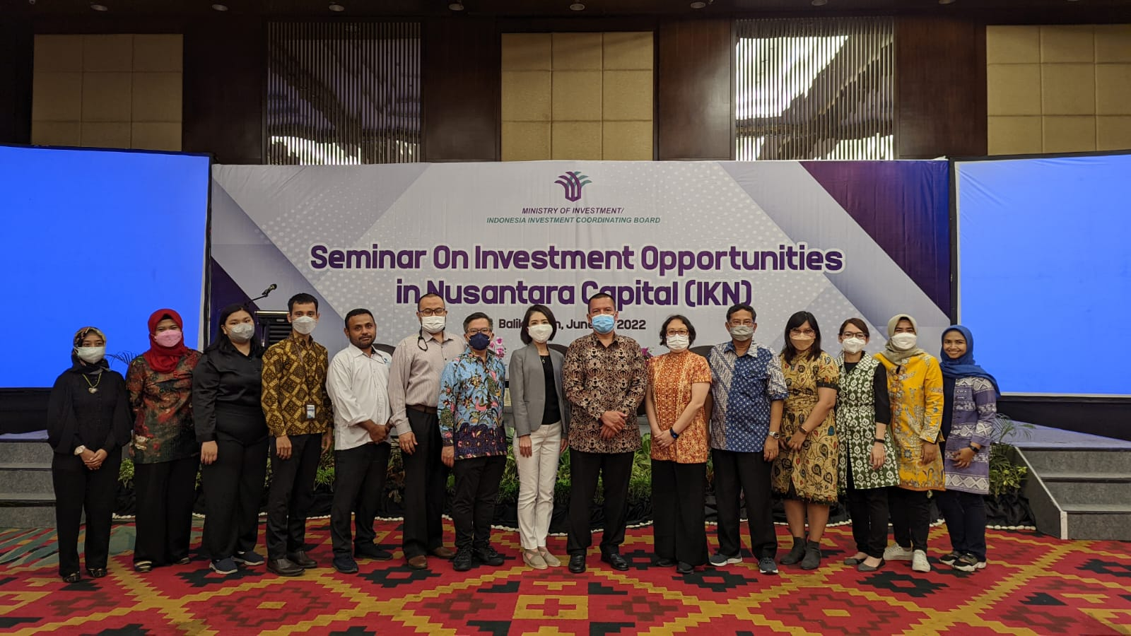
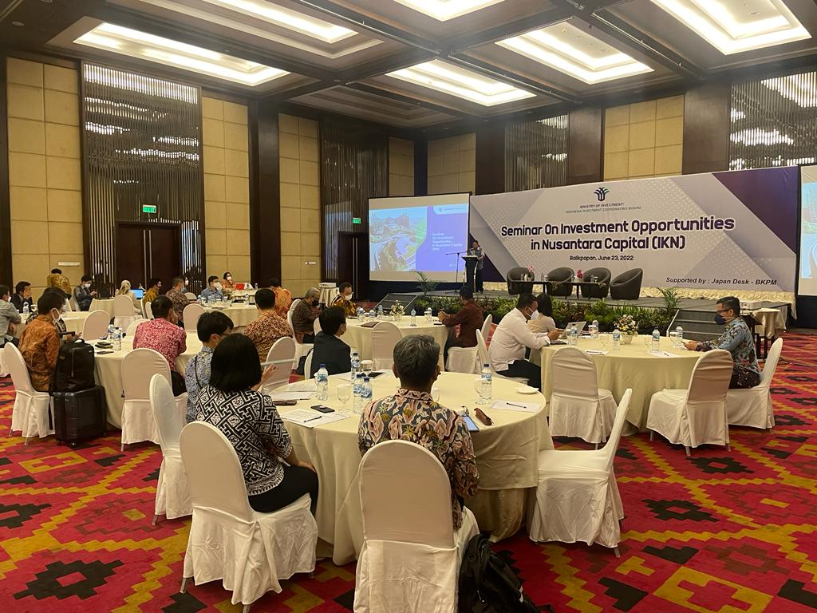
Investment to Build Nusantara (New Capital City)
Out of USD 33 billion investment need, the government is currently planning to cover 19.2% from the state budget (APBN), while the others to be allocated to public-private partnerships (PPPs) (54.4%), and the remainder to pure private investments and state-owned enterprises (26.4%).
Basic service infrastructure
Construction of the State Palace
TNI/POLRI strategic buildings
ASN/TNI/POLRI official residence
Land Procurement
Green open space
Military base
Seminar on Investment Opportunities in IKN, June 23, 2022 supported by Japan Desk BKPM
Total: USD 32.9 Billion
Buildings for the executive, legislative and judiciary
Major infrastructure development (other than those covered by APBN)
Educational facilities, medical facilities
Supporting infrastructure
Public residence
Universities development
Science-techno park
Improvement to airports, ports, and toll road
Medical facilities
Shopping mall
MICE
Source: Ministry of Planning/Bappenas, 2022

Slide 18
Investment Opportunities in Nusantara
the New Capital of Indonesia
Priority investment in KIPP IKN targeted for completion in 2024
The Government Core (KIPP)
Regional Infrastructure
Industry and Economic Cluster
Basic Infrastructure
 | Provision of safe drinking water
 | Liquid waste management
 | Solid waste management
 | Provision of raw water supply
 | Housing
Transportation
 | Access Toll road
 | Airport Express Line
 | Kariangau and Semayang Ports Development
 | New Capital City Airport development
Smart City and Digital Hub
 | Industry 4.0 for existing industry
 | Smart City technology
Inclusive ecotourism & Wellness
 | Ecotourism & wellness tourism
 | Nature and wildlife tourism
 | Urban tourism/multi-purposes hotels
 | Medical tourism
Education in the 21st Century
 | Vocational High School
 | STEM Institute
 | Compulsory education (12years)
Energy Development
 | Solar power plant development
 | Floating Photovoltaic on Semoi Sepaku Dam
Advanced Chemical Industry
 | Petrochemicals
 | Oleochemicals
Sustainable Agriculture
 | Plant-based protein
 | Plant extraction
 | Herbal products and nutrition
Next-gen Renewable Energy
 | TV cell assembly
 | 2-W electric vehicle assembly
Transportation
 | BRT system
 | Intelligent Transport System & Transit System
 | Urban freight transport
Integrated pharmaceutical
 | Active pharmaceutical ingredient
 | Biosimilar
Low-carbon energy
 | Biofuels
 | Electrification, Digitalization, and mining rehabilitation
Priority investment in KIPP IKN targeted for completion in 2024
International Hospital
Integrated Education Facility
Office and Service Area
Mixed Used, Commercial Use
Residential Facilities
Source: Ministry of Planning/Bappenas, 2022
Notes:
https://www.ashurst.com/en/news-and-insights/insights/indonesia-moves-capital-city/

Slide 19
Investment Opportunities in Nusantara Basic Infrastructure
No. | Sub-sector | Location | Goals | Potential Participation from Investor/Interested Party
1. | Drinking Water Supply | Nusantara | Saving Water Usage (L/day) Alternative Water Resources (besides ground water and Regional Water Company) (%) Serving all households with 100% access to drinking water Water Supply Monitored by ICT | Technical assistance in planning, design, development and management. Advanced technology for drinking water system. Research and Development Partnership. Potential collaboration for tertiary distribution pipe investment clusters. Partnership on construction for region, building, or house connection. Partnership to provide junction and other utility in region or residential connection. Partnership to collaborate for rain-water harvesting construction. Collaboration in water recycle construction and usage. Partnership to provide water supply system outside the core zone. Capacity needs up to 5000 liter per second.
2. | Wastewater Management | Nusantara | Domestic Wastewater Service Management. ICT-monitored domestic wastewater piping network . ICT-monitored Settlement-Scale Domestic Wastewater Treatment, in accordance with the effluent quality standard for domestic wastewater treatment. 100% sewerage coverage Centralized monitoring & control for wastewater treatment plant (WWTP) & sewer network Treated water reuse Resources oriented wastewater management | Technical assistance in planning, design, development and management. Advanced technology for wastewater management. Research and Development Partnership. Partnership for Service Operator Development and Design Build Operate (DBO) for: WWTP and sewer network*) Sludge treatment plant*) Recycled water treatment plant NEXUS integrated wastewater-solid waste resource recovery facility. Partnership in recycled water usage for industrial and commercial purpose *) note: in a different area from the area built with the government budget
Source: Ministry of Planning/Bappenas, 2022

Slide 20
Investment Opportunities in Nusantara Basic Infrastructure
No. | Sub-sector | Location | Goals | Potential Participation from Investor/Interested Party
3. | Solid waste management | Nusantara | Waste to Energy. IKN with net zero emission Sorting Management to Waste Processing. Waste Reduction (reduce, reuse, recycle). Sorting from the source Annual rate of solid waste generation reduction up to 2.5% until 2045 Application of IoT-based instruments to monitor residues and recycled products | Technical assistance in planning, design, development and management. Advanced technology for solid waste management. Research and Development Partnership. Partnership for Service Operator Partnership in Waste to Energy Plant Development Development and DBO for: Organic recycling for agricultural products Raw material recycles and treatments from urban waste (steel, plastic, PET, glass powder, paper pulp) Final waste processing with audited emissions budget
4. | Raw water supply | Nusantara and East Kalimantan Province | Safe, reliable, and sustainable water supply to provided whole demands of the population | Technical assistance in planning, design, development, management, and performance Advanced technology for operation, monitoring, and maintenance Research and development partnership Potential collaboration for floating solar PV development on Sepaku Semoi Reservoir Note: All forms of cooperation with private sector should be considering the Law No. 17 on Water Resources of 2019 and the Presidential Regulation No. 16 on Procure
5. | Housing | Nusantara | Housing provision for gov’t officials and general public in accordance with the predetermined specifications. 100% eco-friendly construction for every residential and commercial buildings (site, energy, water and green optimalization). 10-minute walking to essential facilities and public transport nodes. Net zero emission through energy, water and material efficiency. Smart building application. | Technical assistance in planning, design, development and management. Advanced Technology for Green & Smart. Research and Development Partnership. Operator Service Partnership Development and/ Design-Build-Operate Partnership in Plant/Bldg Development Operating and Maintenance Services (PPP) Open for Advisory
Source: Ministry of Planning/Bappenas, 2022

Slide 21
A More Business-Friendly Environment Policies are increasingly open to foreign & domestic investment
Business license process and investment facilities are centralized & simpler at the Ministry of Investment/BKPM
Ministry of Investment/ BKPM issues permits and facilities for all
sectors through the Online Single Submission (OSS) system.
Limitation of foreign ownership in 515 business fields
Incentives for priority business fields
Insentif bagi bidang usaha prioritas
Licensing according to the business risk approach
No more “one size fits all”: The lower the risk of a business activity, the simpler the permits required.
Corporate Tax Income Reduction
25%
22%
Competitive minimum paid-up capital requirements
Minimum paid-up capital is IDR 10 billion (~US$700,000) for Foreign Direct Investment (PT PMA).
< 2020
2020 onwards
Source: Ministry of Investment/BKPM

Slide 22
Simplification of Business Licensing: Risk Based Licensing Approach
Reform on Licensing Process to the Risk-Based Licensing Approach through Online Single Submission (OSS)
Basic Requirement of Business Licensing
Low Risk
Only registration (NIB)
Spatial Conformity (KKPR)
Environmental Approval (PL)
Details refer to GR 22 of 2021
Lower Middle Risk
NIB + Certificate Standard
(SS) (*Self Declare)
Details refer to GR 21 of 2021 and Govt. Regulation No 23 of 2021
Building Approval (PBG)
& Certificate of Eligibility of Building Functioning (SLF)
Upper Middle Risk
NIB + SS
(*Self Declare) with Verification
High Risk
NIB + Permit** (+SS**)
(*Self Declare) with Verification
** Permit through verification
*Details refer to GR 16 of 2021
Source: Ministry of Investment/BKPM

Slide 23
More Investment-Friendly Fiscal Regime
Tax Allowance (Government Reg. 78/2019) | Tax Holiday and Mini Tax Holiday
Import Duty Exemption | Super Tax Deduction (Government Reg. 45/2019)
 | _{200%} Domestic taxpayers who conduct working program, internships and or educational activities to develop human resources based on certain competency could obtain a gross income tax deduction as high as 200% of the funds they had spend for the activities _{60%} Domestic taxpayers who open a new business or expand their existing businesses in labor intensive sectors could enjoy a net income tax deduction of 60% of the capital they invested as fixed assets _{300%} Domestic taxpayers who conduct R&D in Indonesia could obtain a gross income tax deduction as high as 300% of the cost of their R&D activities
50-100% corporate income tax exemption for 5-20 years for investment in pioneer industries.
Reduction of corporate income tax by 30% of the investment value for 5 years for investment in certain business fields and / or regions.
Import duty exemption incentives for imports of machinery and goods and materials for industry and service industries.
Source: Ministry of Investment/BKPM

